Slide 1
Detecting SQL Injection Attack using Natural Language Processing
Individual Task: 2
Group: 35
Submitted By: Kaji Sajjad Hossain
ID: 20101321
Section: 1
Submitted To: Annajiat Alim Rasel
RA: Sabbir and Mehnaz

Slide 2
Outline
● INTRODUCTION
● MOTIVATION
● CONTRIBUTION
● METHODOLOGIES AND EXPERIMENTS
● RESULT
● LIMITATIONS
● FUTURE WORK
● CONCLUSION

Slide 3
Introduction
Highlights the increasing number and severity of online attacks, particularly those related to web applications.
Identifies SQL Injection (SQLI) as a major threat to web application security.
Points out the limitations of traditional methods (input validation, filtering) and the need for machine learning-based solutions.

Slide 4
Motivation
Emphasizes the critical impact of SQLI attacks on web application security.
Refers to the historical context of SQLI attacks and their consequences.
Highlights the inadequacy of previous machine learning approaches due to high false positive and false negative rates.

Slide 5
Contribution
Introduces a novel approach that utilizes Natural Language Processing (NLP) and BERT for feature extraction.
Claims the proposed model achieves a 97% accuracy with a low false positive rate of 0.8% and a false negative rate of 5.8%.

Slide 6
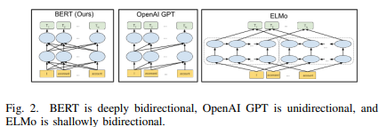
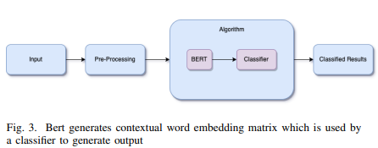
Methodology
Mentions the use of BERT, a bidirectional contextual learning model, for feature extraction.
Describes the data preprocessing steps, including handling null values, filtering unique records, and shuffling the dataset.
Outlines the proposed model architecture, involving five layers: Input, Keras, BERT encoder, Dropout, and Classifier.

Slide 7
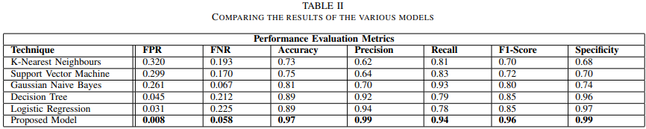
Results
Provides a comparative analysis of the proposed model against traditional classifiers (K-Nearest Neighbours, SVM, Naive Bayes, Decision Tree, Logistic Regression).
Demonstrates superior performance of the proposed model with low false positive and false negative rates, and high accuracy, precision, recall, F1-score, and specificity.

Slide 8
Limitations
Potential limitations could include the specific nature of the dataset, the generalization of the proposed model to diverse scenarios, or computational requirements.
The computational expense of pre-training BERT is another drawback.

Slide 9
Future Work
Suggests extending the research to incorporate other NLP models like RoBERTa and XLnet.
Proposes exploring SQLI detection in other query languages, such as Hive Query Language (HQL), especially in distributed environments.

Slide 10
Conclusion
Summarizes the severity of SQLI attacks and their impact on the confidentiality, integrity, and availability of web-based applications.
Highlights the contribution of the proposed model, combining NLP and BERT, in achieving state-of-the-art results with low false positive and false negative rates.
Expresses the potential for future research extensions, including the use of additional NLP models and coverage of other query languages.

Slide 11
Thank You

